Slide 1

NumPy

Slide 2


LEARNING OBJECTIVES
Understand what is NumPy
Learn to create and use NumPy arrays
Learn about NumPy array attributes
Learn to index and slice arrays
Understand array operations
Learn the different ways of creating arrays
Understand random number generation

Slide 3
What is NumPy?

Slide 4
What is NumPy?
It is third party library which is used extensively in scientific and mathematical computing.
It really is a word play of the terms NUMeric PYthon
It is used by data analysts and data scientists for its flexibility, computation speed, and simplicity.

Slide 5
What is NumPy?
It is a Python library that provides:
A multidimensional array object
Various derived objects (such as masked arrays and matrices)
An assortment of routines for fast operations on arrays, including mathematical, logical, shape manipulation, sorting, selecting, I/O, discrete Fourier transforms, basic linear algebra, basic statistical operations, random simulation, etc.

Slide 6

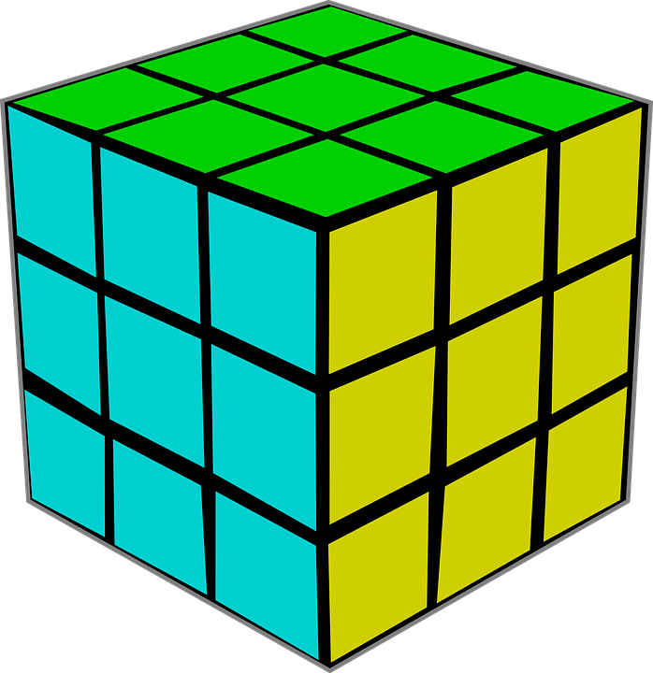
What is NumPy?
ndarray object
It is at the core of the NumPy package.
It encapsulates n-dimensional arrays of homogeneous data types, with many operations performed in compiled code for performance.

Slide 7
What is NumPy?
Important differences between NumPy arrays and the standard Python sequences
NumPy array operations are efficient than Python sequences or array operations using C, for example, multiplying each element in a 1-D sequence with the corresponding element in another sequence of the same length.
Python code to do this using lists.
c = []
for i in range(len(a)):
c.append(a[i]*b[i])
It executes slower than C code.
If a and b each contain millions of numbers, you will pay the price for the inefficiencies of looping in Python.
C code to do this using arrays
c = []
for (i = 0; i < rows; i++): {
c[i] = a[i]*b[i];
}
It saves all the overhead in interpreting the Python code and manipulating Python objects.
The coding work required increases with the dimensionality of the data. For example, for 2-D arrays it expands to
for (i = 0; i < rows; i++): {
for (j = 0; j < columns; j++): {
c[i][j] = a[i][j]*b[i][j];
}
NumPy code to do this using lists
c = a * b
The code works at near C speed and is simple due to NumPy’s features of vectorization and broadcasting.
NumPy gives the best of both worlds. Element-by-element operations are the “default mode” when a ndarray is involved, but the operation is speedily executed by pre-compiled C code.
Source: https://numpy.org/doc/stable/user/whatisnumpy.html

Slide 8
Creating and using NumPy Arrays

Slide 9
Creating and using NumPy Arrays
Prerequisites
Installing NumPy
Use the following command to install Numpy using Jupyter Notebook.
Importing numpy as alias np is a common practice

Slide 10
Creating and using NumPy Arrays
NumPy array
It looks similar to a list.
It is a grid of values indexed by positive integers.
It generally contains numeric values. However, it can also have strings.
It works faster than lists.
It can be multidimensional.

Slide 11
Creating and using NumPy Arrays
Demo of Creating and using NumPy Arrays

Slide 12
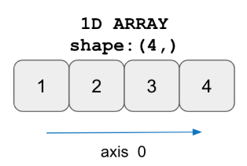
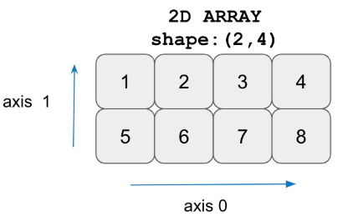
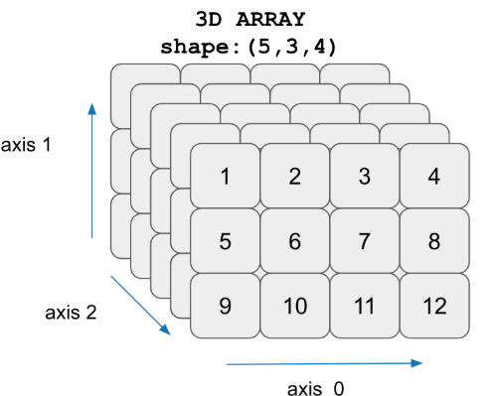
Creating and using NumPy Arrays
Types of NumPy arrays
1D NumPy array
2D NumPy array
3D NumPy array
It contains elements only in one dimension.
Therefore, the shape of the Numpy array should contain only one value in the tuple.
It is an array within an array.
The position of a data element is referred to by two indices instead of one.
It comprises three nested levels of arrays, one for each dimension.
Note: NumPy is fast with multi-dimensions.

Slide 13
Creating and using NumPy Arrays
Demo of Creating and using NumPy Arrays

Slide 14
NumPy Array Attributes

Slide 15
NumPy Array Attributes
They are the features or characteristics that describe the object.
shape
size
dtype
ndim
They do not have parentheses following them.
For example, some attributes of the Numpy array are:

Slide 16
NumPy Array Attributes
Demo of NumPy Array Attributes

Slide 17
Array Indexing and Slicing

Slide 18
Array Indexing and Slicing
Indexing a NumPy array
The element in the array can be accessed by its positional index.
The index for an array starts at 0 from left and at -1 from the right.
It is the same for a list or string or any other sequence type.

Slide 19
Array Indexing and Slicing
Demo of Array Indexing and Slicing

Slide 20
Array Indexing and Slicing
Slicing 1D array elements
The general format to slicing ID array elements is:
Array_Name [lower_range: upper_range: step]
Note: Array elements from lower range to upper_range -1 are extracted.
weight
73 | 68 | 55 | 43 | 92 | 66
0 | 1 | 2 | 3 | 4 | 5
Index = 0 to 5
To extract
[43 92] use weight[3:5], the upper range (5) is not included.

Slide 21
Array Indexing and Slicing
Demo of Array Indexing and Slicing

Slide 22
Array Indexing and Slicing
Examples: Slicing 1D array elements
weight
73 | 68 | 55 | 43 | 92 | 66
0 | 1 | 2 | 3 | 4 | 5
Index = 0 to 5
To extract
All elements ([73 68 55 43 92 66]) use weight[:]
[73 43] use weight [::3], here 3 is the step/jump
The first 3 elements [73 68 55] use weight [:3]

Slide 23
Array Indexing and Slicing
Demo of Array Indexing and Slicing

Slide 24
Array Indexing and Slicing
Slicing 2D array elements
The general format to slicing 2D array elements is:
Array_Name [start_row_index: end_row_index, start_col_index: end_col_index]
Example: How to extract Array [1:, :2] from the original array?
Here start_row_index = 1, end_row_index = 2 (as it not given), start_col_index = 0 (as it is not given), and end_col_index = 2
Original array
10 | 20 | 30
40 | 50 | 60
70 | 80 | 90
Extract rows (1, 2)
40 | 50 | 60
70 | 80 | 90
Extract columns (0, 1)
40 | 50
70 | 80

Slide 25
Array Indexing and Slicing
Demo of Array Indexing and Slicing

Slide 26
Array Indexing and Slicing
Examples: Slicing 2D array elements
array [1] or array [1:2, :]
40 | 50 | 60
Original array
10 | 20 | 30
40 | 50 | 60
70 | 80 | 90
array [0,1:] or array [0:1, 1:]
20 | 30

Slide 27
Array Indexing and Slicing
Demo of Array Indexing and Slicing

Slide 28
Array Operations

Slide 29
Array Operations
Demo of Array Operations

Slide 30
Array Operations
Multiplication of 1D array
arr [ 50 100 150 200]
brr [ 40 80 120 160]
crr [ 2000 8000 18000 32000]

Slide 31
Array Operations
Demo of Array Operations

Slide 32
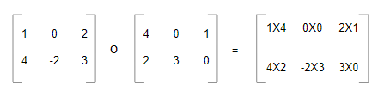
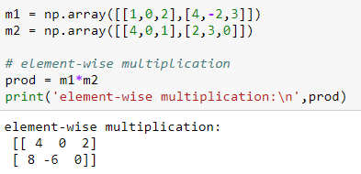
Array Operations
Element-wise multiplication or Hadamard Product of two matrices
m1
m2
m1 * m2

Slide 33
Array Operations
Demo of Array Operations

Slide 34
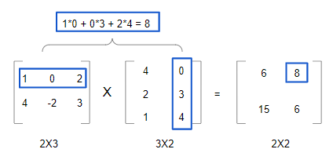
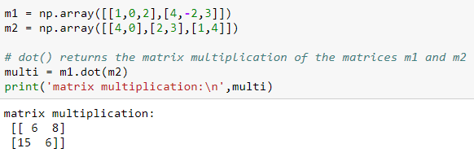
Array Operations
Matrix multiplication of two 3x3 matrices

Slide 35
Array Operations
Demo of Array Operations

Slide 36
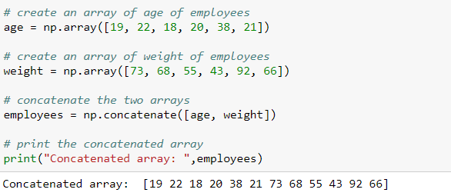
Array Operations
Concatenate 1D array
Two or more arrays will join along the existing (first) axis, provided they have the same shape.
Note: You cannot concatenate the arrays with different dimensions.

Slide 37
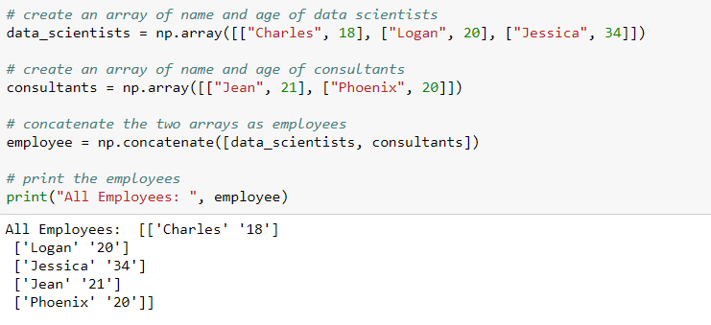
Array Operations
Concatenate 2D array
You can concatenate 2D arrays either along rows (axis = 0) or columns (axis = 1), provided they have the same shape.

Slide 38
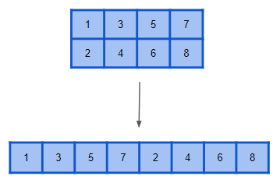
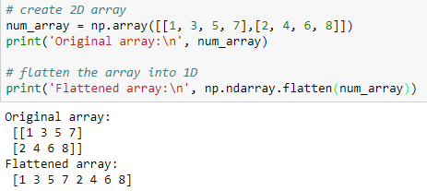
Array Operations
Flatten the array
The flatten() function collapses the original array into a single dimension.

Slide 39
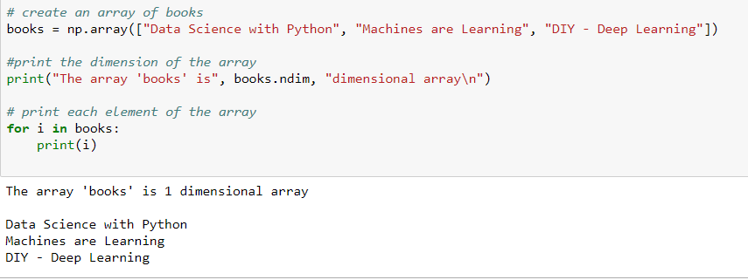
Array Operations
Iterating through an 1D array
You can use the for loop to iterate through the array elements.

Slide 40
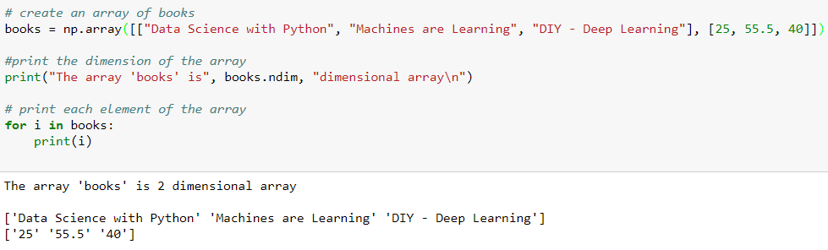
Array Operations
Iterating through a 2D array

Slide 41
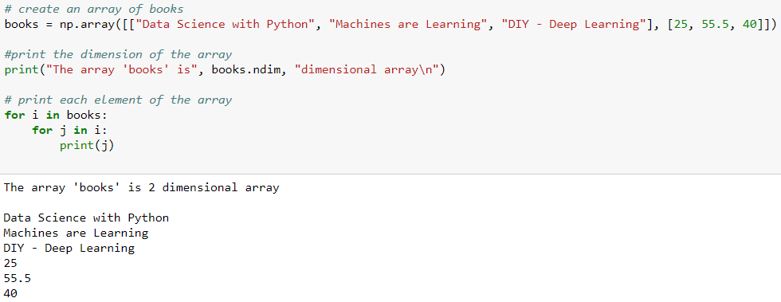
Array Operations
Iterating through a 2D array using the nested for loop
To print each element in the 2D array, use the nested for loop.

Slide 42
Array Operations
Demo of Array Operations

Slide 43
Different Ways of Creating Arrays

Slide 44
Different Ways of Creating Arrays
Creating a NumPy array using arange()
You can use np.arange() to create a NumPy array.
The numbers generated have the same difference.
The function generates as many possible numbers in the given range.
The function name
The data type (optional)
Numpy.arange (start, stop, step, dtype)
The start of the interval (optional). Default is 0
The “step” between values (optional)
The end of the interval

Slide 45
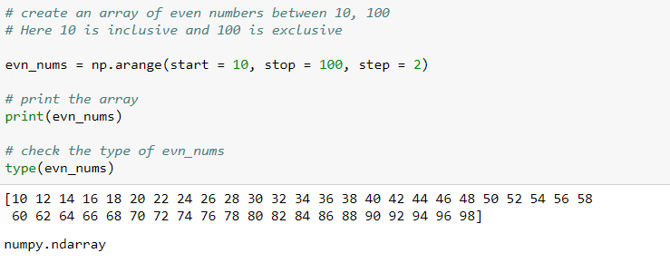
Different Ways of Creating Arrays
Creating a NumPy array using arange()
The np.arange() create a series of values from 10 to 100 with a difference of 2, stored as a NumPy array.

Slide 46
Different Ways of Creating Arrays
Creating a NumPy array using linspace()
The linspace() generates a specified number of values in a specified range.
The start of the interval (optional)
The number of values required in the interval
numpy.linspace ( start, stop , num, dtype )
The end of the interval
The data type (optional)

Slide 47
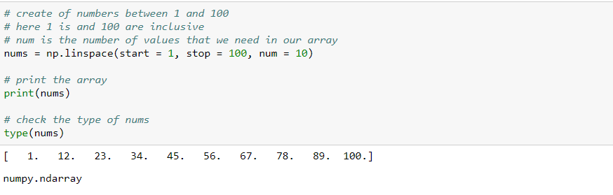
Different Ways of Creating Arrays
Creating a NumPy array using linspace()
np.linspace() produces a sequence of 10 evenly spaced values from 1 to 100, stored as a NumPy array.

Slide 48


Different Ways of Creating Arrays
Creating NumPy arrays of 0s and 1s
Creating 1D Numpy array of 0s
Creating 1D Numpy array of 1s

Slide 49
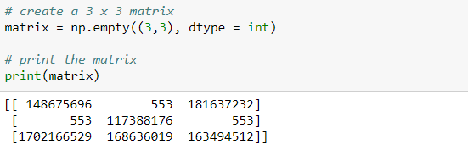
Different Ways of Creating Arrays
Creating a 2D NumPy array
np.empty() returns the matrix with arbitrary values of given shape and data type.
‘dtype = object’ returns None values.
Notes:
●

Slide 50
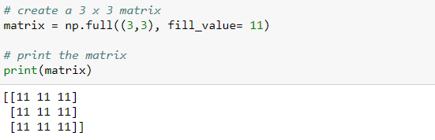
Different Ways of Creating Arrays
Creating a 2D NumPy array
np.full() returns the matrix of the given shape with the value set by the ‘fill_value’ parameter.
Notes:
●

Slide 51
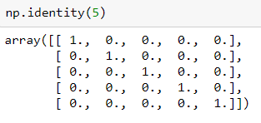
Different Ways of Creating Arrays
Creating a 2D NumPy array
np.identity() returns identity the matrix of the specified shape.
Notes:
●

Slide 52
Random Number Generation

Slide 53
Random Number Generation
To generate random numbers, import the random module from NumPy
Function | Description | Example
randint(low, high, size, dtype) | Fetches a random integer within the specified range, if the size is omitted else fetches a set of random numbers | random.randint(50) random.randint(20, 50) random.randint(100, size = (5)) random.randint(400, size = (4, 5))
rand (size) | Generates a floating-point value between 0 and 1, if size is omitted else generates a set of random numbers | random.rand() random.rand(5)
choice(a, size=None, replace=True, p=None) | Fetches a random sample from a 1D array | random.choice (list x) random.choice (list x, size (2,3))

Slide 54
Random Number Generation
Demo of Random Number Generation

Slide 55
Random Number Generation
Assume you are working with a dataset that of about 1000 patients.
You want to monitor the behavior of a drug or antidote on 600 random patients.
Use the choice function from the random module to get the data on day 1 for 600 random patients.
However, if you use the choice method on day 2, you may get a different set of random patients.
So, to get the same set of random patients, use the seed functionality.
Seed helps you get the same random dataset if you use the same seed number.

Slide 56
Random Number Generation
Demo of Random Number Generation

Slide 57

Thank You!
Copyright © Knowledgehut., All rights reserved
Confidential Information, intended for approved distribution list of Knowledgehut

